Slide 1
CS 688 Final Project
Michael Barrera
2 May 2019

Slide 2
A traditional industry's response to rapid change...
The auto industry has seen it's fair share of disruptions lately. Many companies in this space have seen significant swings in their stock performance... some good, some bad. As in other industries, rapid innovations in technology have shifted consumer habits when it comes to buying cars. The traditionally conservative and change-averse auto industry has struggled to keep pace. The following presentation examines six automotive stocks and demonstrates the correlation between stock performance and Twitter sentiment.

Slide 3
Methodology
Closing prices of various automotive stocks were examined on Monday, April 29 2019. Stocks with price changes of 1% of more over the previous close were examined further. Because of the volatility of individual stocks from day to day, I also examined the long term performance of some of these stocks.

Slide 4



Biggest Gainers
CarMax (KMX) +2.62%
Ford Motor Company (F) + 2.47%
Carvana (CVNA) + 2.33%

Slide 5


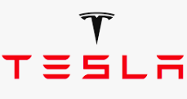
Biggest Losers
Tesla (TSLA) -1.96%
General Motors (GM) - 2.04%
Sonic Automotive (SAH) - 1.23%

Slide 6

Part a – Search Tweets
Using the Twitter API, 100 tweets associated with each of the six companies were collected and stored in copora for analysis.
Since our interest is primarily analyzing sentiment around the recent stock performance of these companies, I felt that a cashtag search was most appropriate to get the most reliable data.

Slide 7

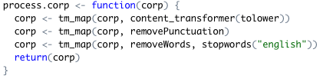
Parts b/c - Process & store tweets
After collecting the raw data from twitter, I created 2 simple functions to:
Take a set of tweets and return a corpus
Take an unprocessed corpus, clean it up, & return a cleaner corpus

Slide 8
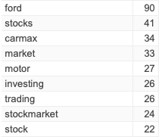
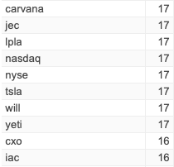
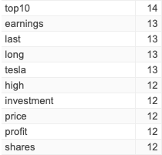
Most frequent terms - Gainers

Slide 9
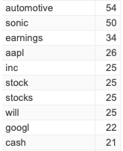
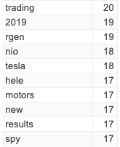
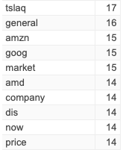
Most frequent terms - Losers

Slide 10

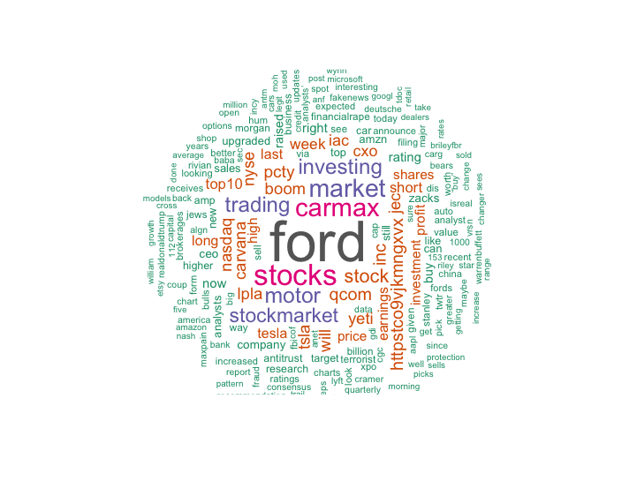
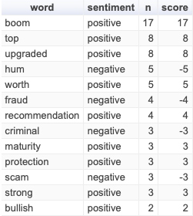
Wordcloud: Gainers

Slide 11
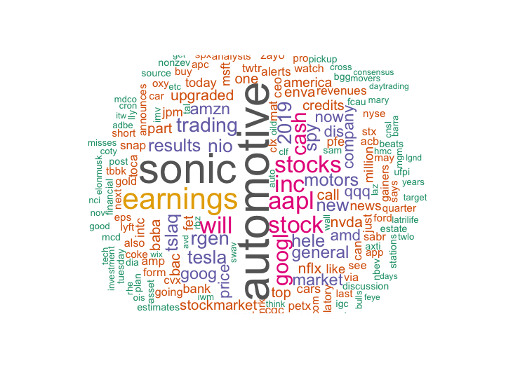
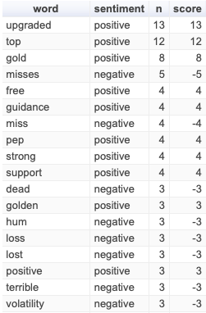
Wordcloud: Losers

Slide 12


Sentiment scores
Sentiment score for the gainers: 18
Sentiment score for the losers: -2

Slide 13
Conclusion
The sentiment scores of 18 for the gaining stocks and -2 for the losing stocks suggest that there may indeed be a correlation between social media sentiment and company performance. However, more robust analysis would be needed to determine the strength of the correlation and whether this information could be used to predict future stock performance. In other words, is the sentiment a reflection of the performance or is the performance a reflection of the sentiment.

